Slide 1
A.I Assignment 1
By: Ibrahim Abou Zahr

Slide 2
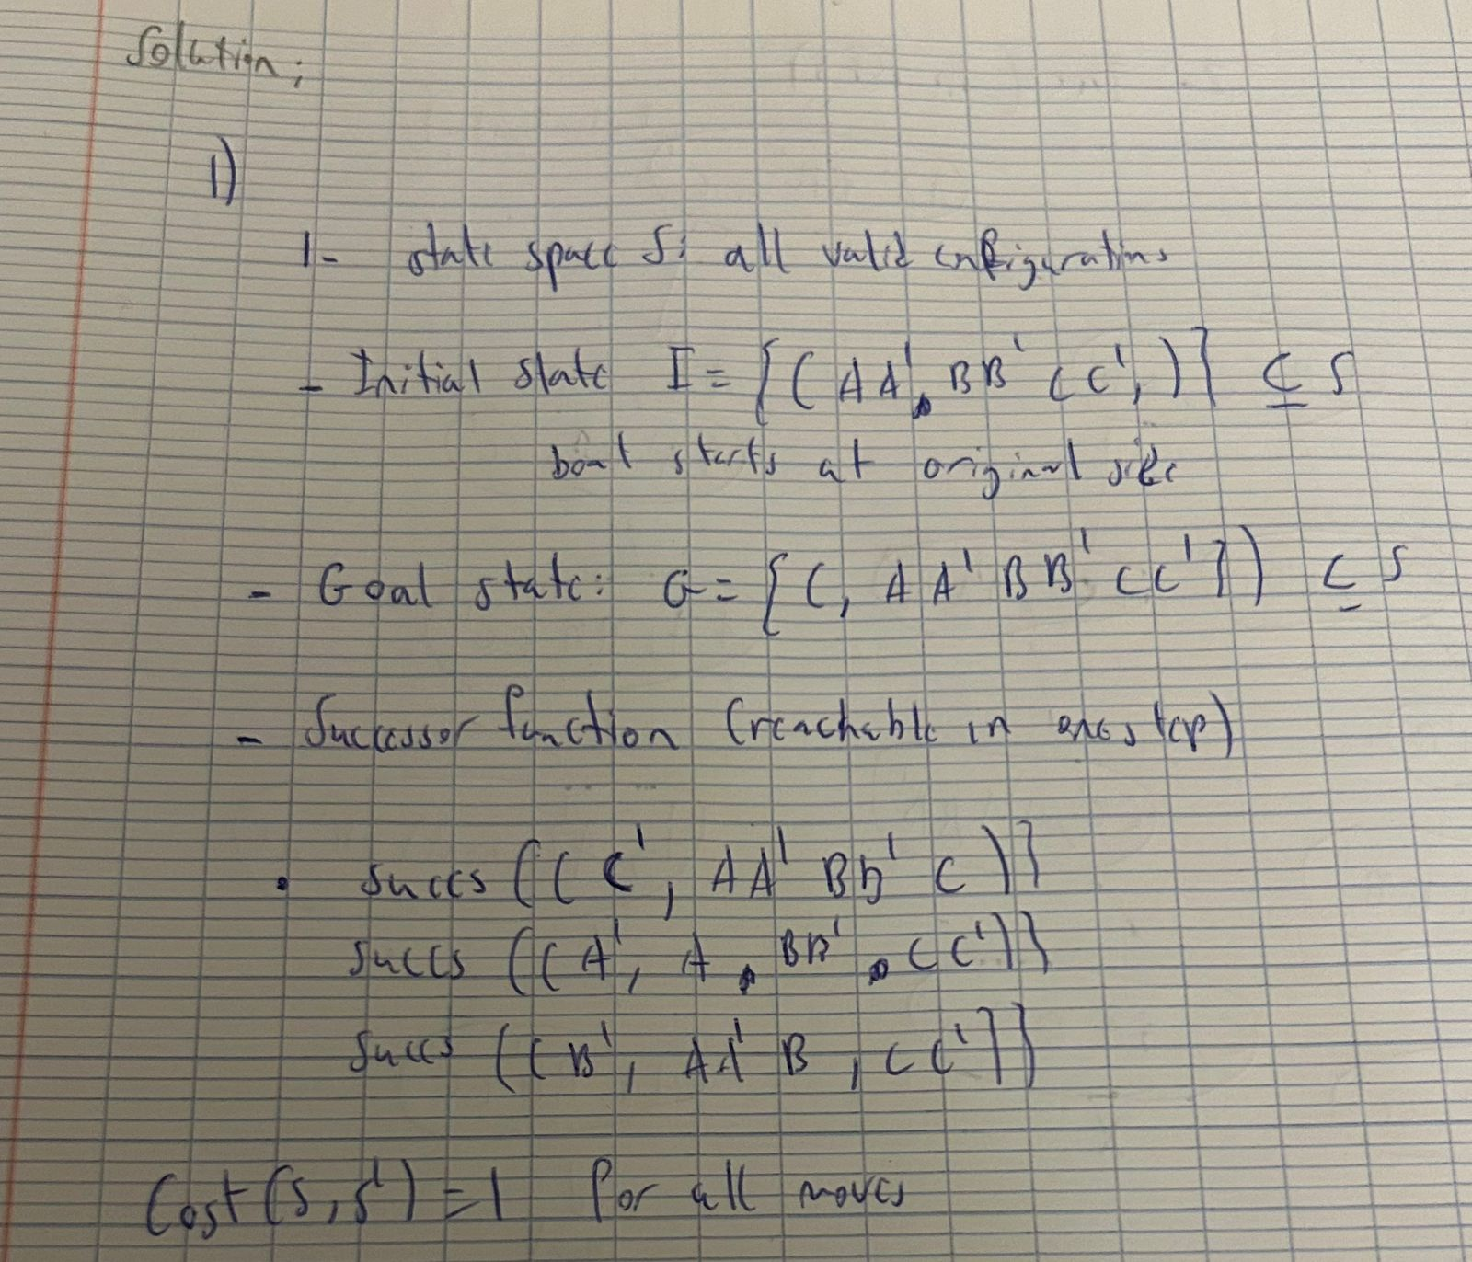
1- Problem Formulation

Slide 3
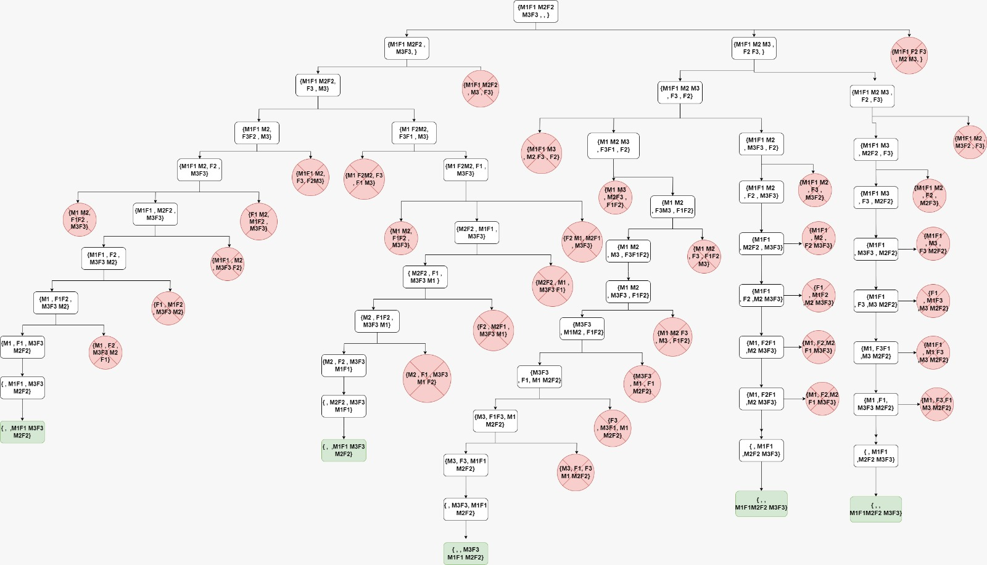
Graph Space

Slide 4
Search Techniques
BFS: We use level order search to find goal state.
0 1 2 3 4 5 6 7 8 9 10 11 12 13 14 15 .... 72
Solution: 0 1 4 8 15 26 37 46 66 72
.DFS: Pre order traversal, PLR.
0 1 4 8 15 26 37…etc
Solution: 0 1 4 8 15 26 37… 72 (goal)
UFS: uniform cost search (cost is 1 per move)
Solution: shortest path used (least costly): 0 1 4 8 15 26 37 46 46 66 72
IDS: DFS + BFS ( go level by level and after finishing a level we iterate again by starting from the initial state)
Solution: : 0 1 4 8 15 26 37 46 46 66 72

